Slide 1
Scripting and Email Notifications in bound and outbound

Slide 2
Email Notifications:
Create inbound action for New, Reply, Forward.
Create new type inbound action for ITIL users only.
Create new type inbound action for Abel tuter only.
How to eliminate guest user in incident caller when you create inbound action from the mail which is not present in the user table.
Create new inbound action for problems whenever a user sends email from not registered mail it should create one user account in the user table.
Create a reply inbound action for the problem table with problem statement as email subject, Category as software, and description should update with email body.
Create Forward inbound action for problems to create new records.
Create a new inbound action for any custom table to create a new record.
requirement:1
Create a outbound notification in incident table for caller, cmdb asssignedto person,akrc701@gmail.com,callerdepartmenthead.
Whenever short description contains security word.
With Subject: Notify users -RPS
Body:
Hi Team,
Security ticket has been created please check the details.
Short description :
Description:
Configuration item :
thanks
requirement 2:
2. Create notification on incident table when caller is VIP and category is network to the users of network group and Caller manager with
Subject: VIP caller ticket
Body : Hi Team,
VIP user raised the ticket please address this ASP please make it as priority 1 ticket.
Requirement 3:
Check the inbound actions functionality and do research on the inbound actions.
Requirement 4:
8.Create a notification on incident table When Configuration item is Asset IBM or Annie IBM, TO the configuration item Assigned to person, Network group. with
Subject : CI related ticket (Number) is create
Body : Hi ,
Ticket Number(INC0000123) ( ticket number should come hyper link) is created please work on the ticket.
3. Create a notification on event is fired and triggered explore this.
4. Check the inbound actions functionality, new , reply forward

Slide 3
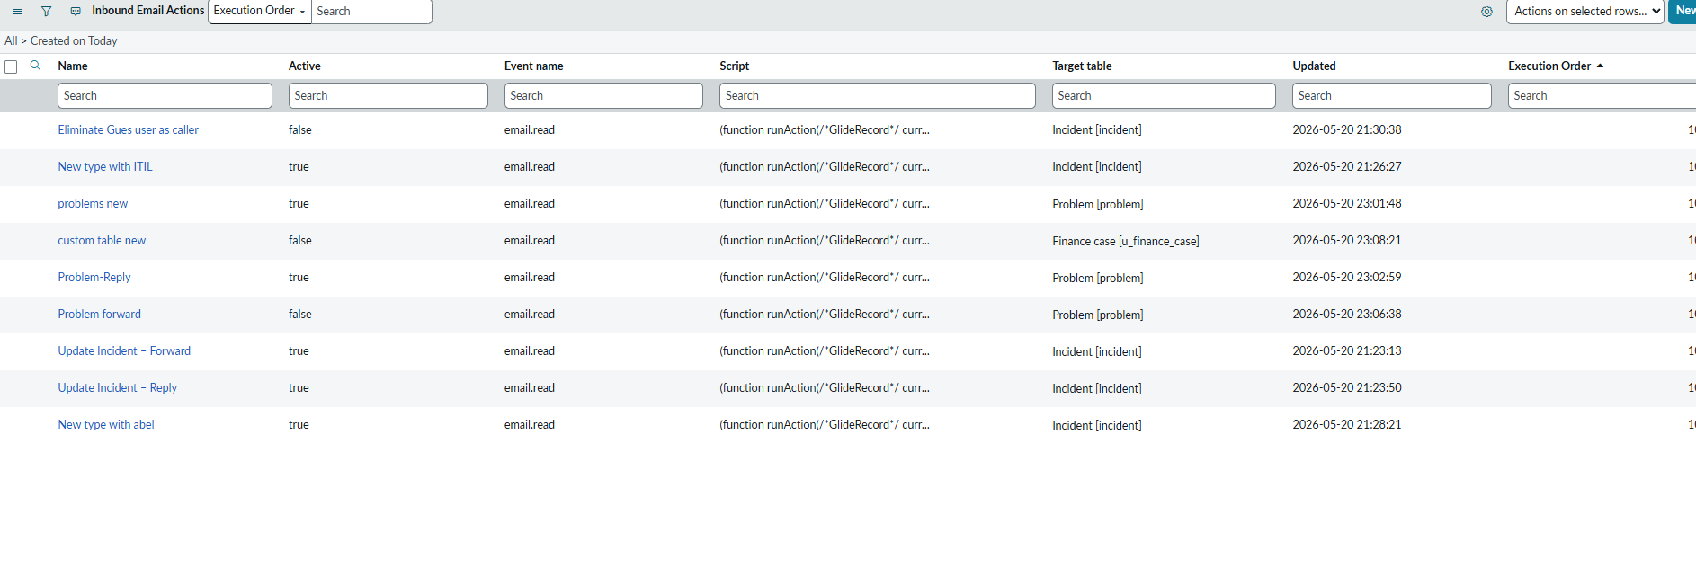
Inbound email actions tasks

Slide 4
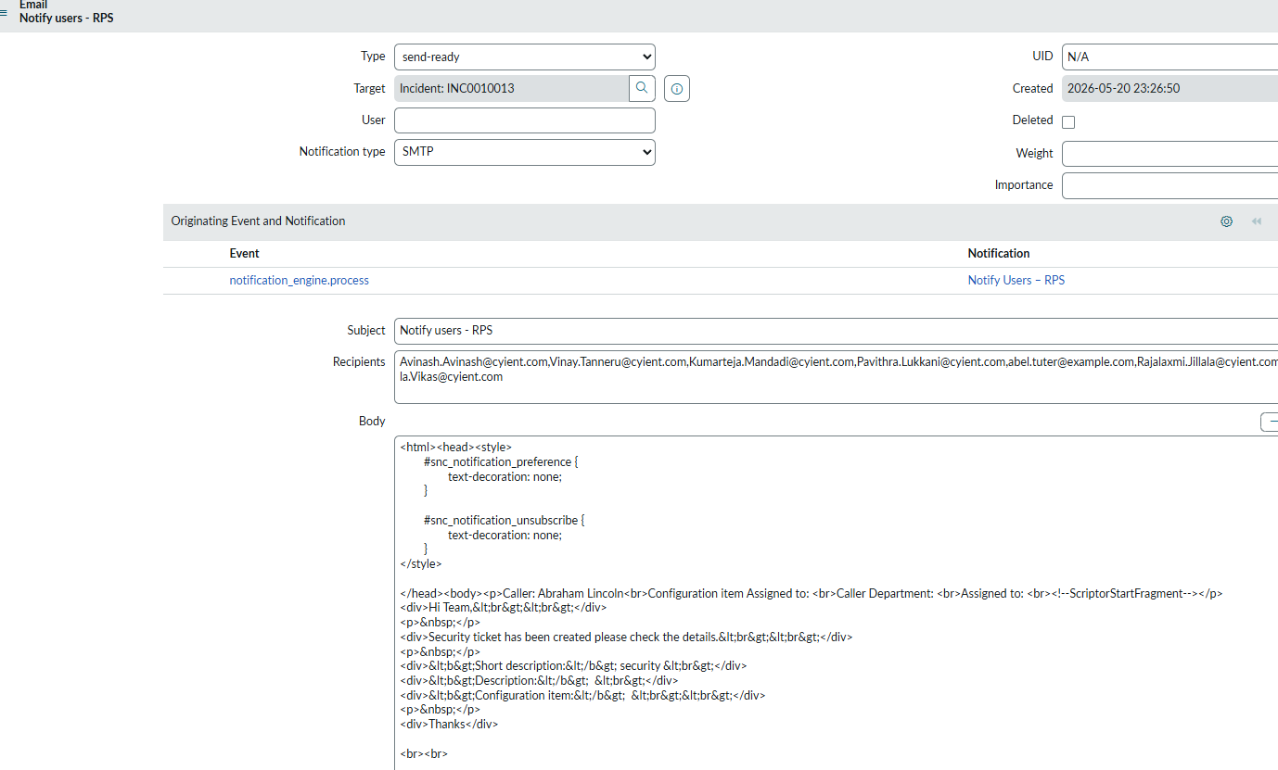
Outbound email tasks

Slide 5
Client scripts
Client scripts :
Populates the logged-in user automatically in the caller field only for new Records.
If a logged in user has an itil role, make the description ,channel mandatory.
Display the info message for the new record of the incident with “This is the new record of the incident (incident number ex: INC12345).
Create a Custom Role named as internal_tsb ,add it to the user.Disable Attachment feature on incident form if the logged in user is holding a custom role.
If the logged in user is abel tuter set the configuration item as AssetIBM, and description set with ‘’This is abel tuter ticket please take as priority to resolve’, It should work with new record only.
Autopopulate logged in user in the opened on behalf of variable in variable set of your catalog project.
Hide task SLA related list in the incident for category network records.
Hide task SLA related list for the Users holding Admin Role.
Hide all related Lists for the tickets with category hardware tickets.
If a user changes the caller in the incident form : Description should be the incident is created by the user : caller full name , cmdb mandatory,state should be in progress.
Populate the description in the incident with contact type - email.phone,walk-in,self service,If drop down changes value should change accordingly.
Create Two checkboxes named as Analysis review and Analysis approved If analysis review is true, Analysis approve should be true automatically and vice versa.

Slide 6
Create a dropdown named as “Related Section” with 3 options by including none with values like Approvals,Governance, Ticket metrics. Create 3 sections named as Approvals,Governance, and Ticket metrics. Display the section based on the Dropdown selection.
Restrict form submission if the assignment group and assigned to is not filled.
Restrict the incident table category from hardware in the list show alert message Security Restrictions cannot edit.
Restrict the change of state to “in progress” from the list if the user has an itil role.
Populate alert messages while submitting the form with category software. If the category is software ,set the values in the description as “this is software ticket”.
On the catalogue item create two select box variables Operating system and Os Versions
Operating system - Windows,Ubuntu,Linux,Mac OS .
OS Versions : 2007,windows10,windows11,Ubuntu 21.10,Ubuntu 20.04.3 LTS,Gentoo,Debian,Big Sur,Monterey
for selection of
⇒ Windows -2007,windows10,windows11
⇒ Ubuntu - Ubuntu 21.10,Ubuntu 20.04.3 LTS,
⇒ Linux - Gentoo,Debian,
⇒ Mac OS - Big Sur,Monterey
When assigned to is empty, please make urgency mandatory.
If the caller is abel tutor , make the description field mandatory.
Set impact field mandatory if priority is changed to critical.
If caller id is fred luddy restrict form submission.put an alert.
If the description field is empty, set the contact type as self service else change the contact type to ‘walk in’.
If the problem field on the incident form is empty, restrict form submission.put an alert.
If category is none hide sub category field on form.
Population assigned to Joe employee when contact type is phone.
If the role is admin it should not allow a short description to edit the list.
If the caller is abraham lincoln set the category to hardware and Remove phone choice in Channel field.
When an incident is assignedTo someone show an alert message(this ticket is assigned to the assigned name).
When a login user is ITIL populates the Help Desk group.
Based on the choice selection checkbox should be checked,
Knowledge checkbox should be checked if the priority is 1.
Take two fields Requested For and Manager, If requested for selected Manager should populate accordingly.
Should not allow users to change the category to network in the list view. Display error message when user tries to change (You cannot change the category to Network).
If analysis review checkbox checked state should move to inprogress.Else it should be a new state.

Slide 7
EMAIL SCRIPTS
Caller Incident Count + Link in Notification Hi ${caller_id},<br><br>
Your incident has been created.<br><br>
${mail_script:caller_incident_count}
Thanks
Count of Problem Tickets Assigned To ${mail_script:problem_count_assigned}
Display Data in Table Format (Email Body)

Slide 8
Reference qualifiers
If a logged in user is a member of any of those 5 groups then show all groups including those 5. If a logged in user is not a member of any of those 5 groups then show all groups excluding those 5 groups.
var groups = ['group_sysid1','group_sysid2','group_sysid3','group_sysid4','group_sysid5'];
var gr = new GlideRecord('sys_user_grmember');
gr.addQuery('user', gs.getUserID());
gr.addQuery('group', 'IN', groups.join(','));
gr.query();
if (gr.hasNext()) {
// User is member → show all groups
answer = '';
} else {
// Not member → exclude those 5 groups
answer = 'sys_idNOT IN' + groups.join(',');
}
We need all the Active users in the Caller Field and all users must belong to the IT Team only. active=true^department.name=IT

Slide 9
I want the VIP user available in the Caller Field of Incident Table.
vip=true
Show users in the caller field who belong to the same department as the logged in users department. answer = 'department=' + gs.getUser().getDepartmentID();
Show only open changes in a related Change Request field.
state!=closed
We want to show/filter the users in the caller field whose location is the same as the Value of Location in the Incident Form. answer = 'location=' + current.location;

Slide 10
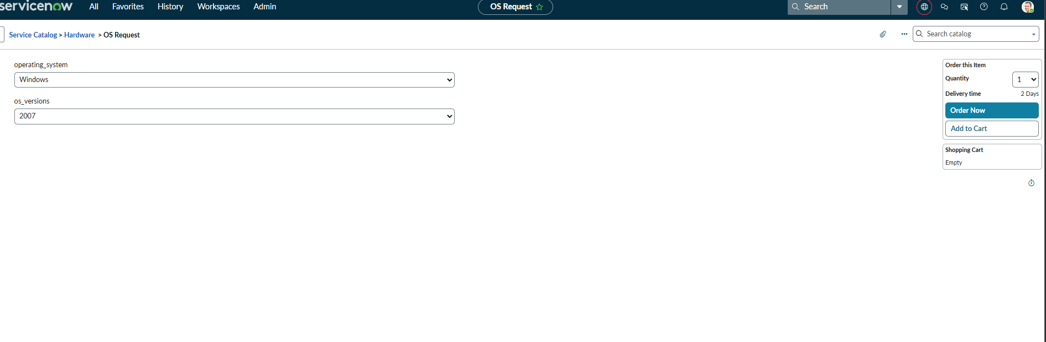
Os request catalog item we used on change client scripts

Slide 11
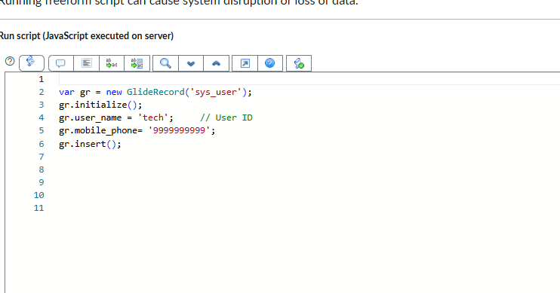
Glide Record Insert a record in the user table with Userid as tech, phone num as 9999999999.

Slide 12
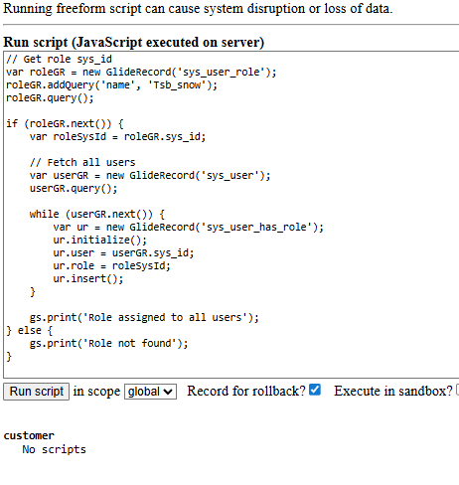
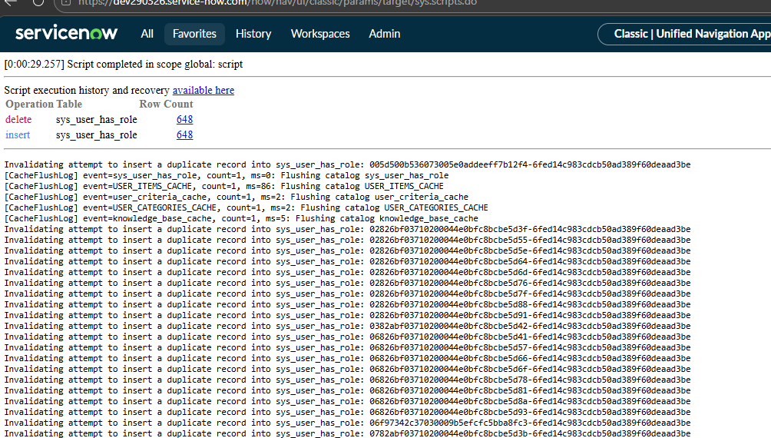
Create a custom role ‘’ Tsb_snow’’, Assign this role to all the users in servicenow. By using Background script.

